Slide 1
IoT Microcontrollers: Onboarding a Raspberry Pi using Raspbian
https://www.aws.training/Details/Video?id=26564

Slide 2
Steps
Create an IAM role for IoT called IoTAccess
Enable logging for IoTAccess (IoT Core / Settings)
Create a thing type called myController (IoT Core / Manage / Type) note: this is not in the video
Onboard Device (myPi)

Slide 3
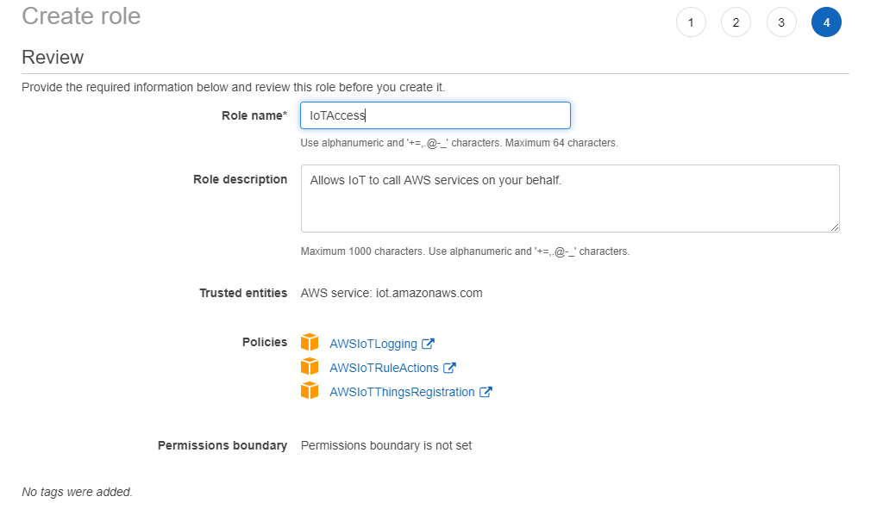

Slide 4
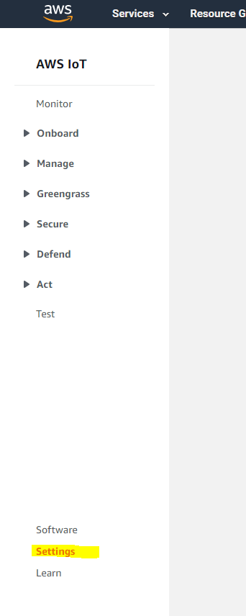
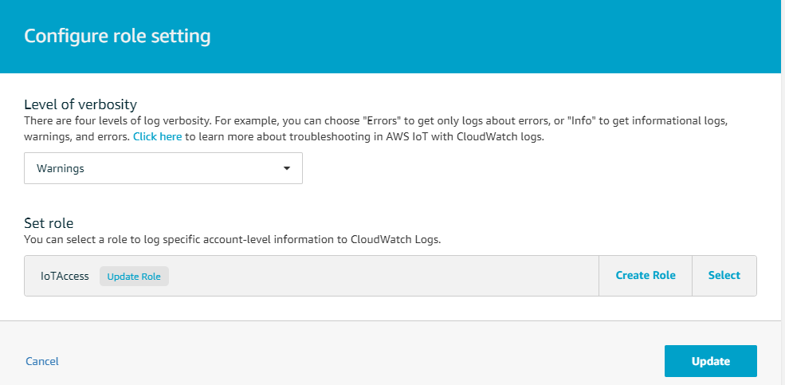
Enable logging

Slide 5
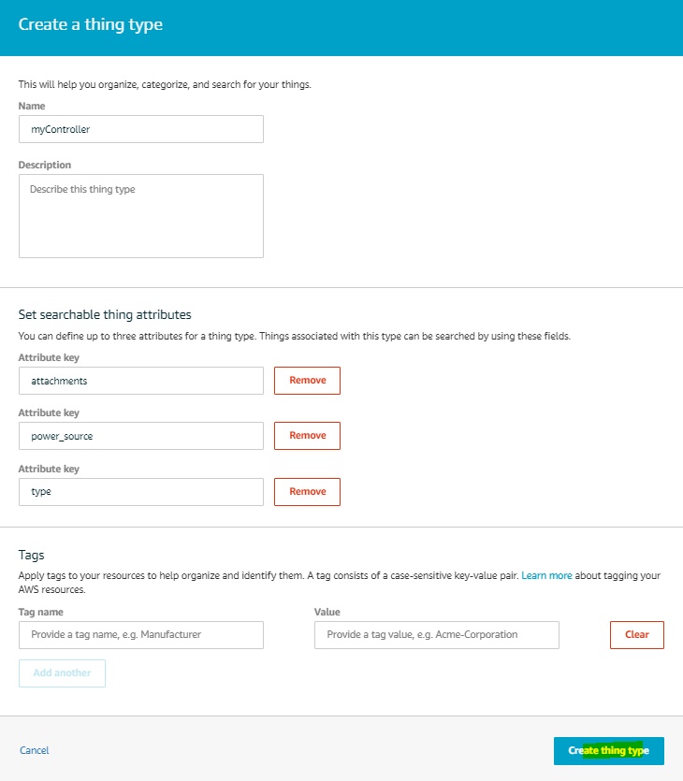
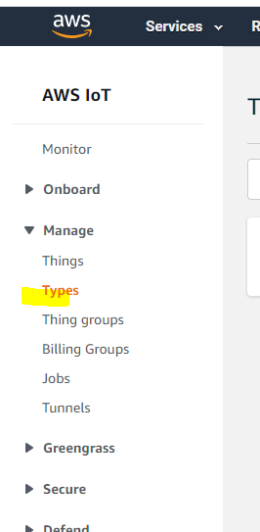
Create a thing type

Slide 6
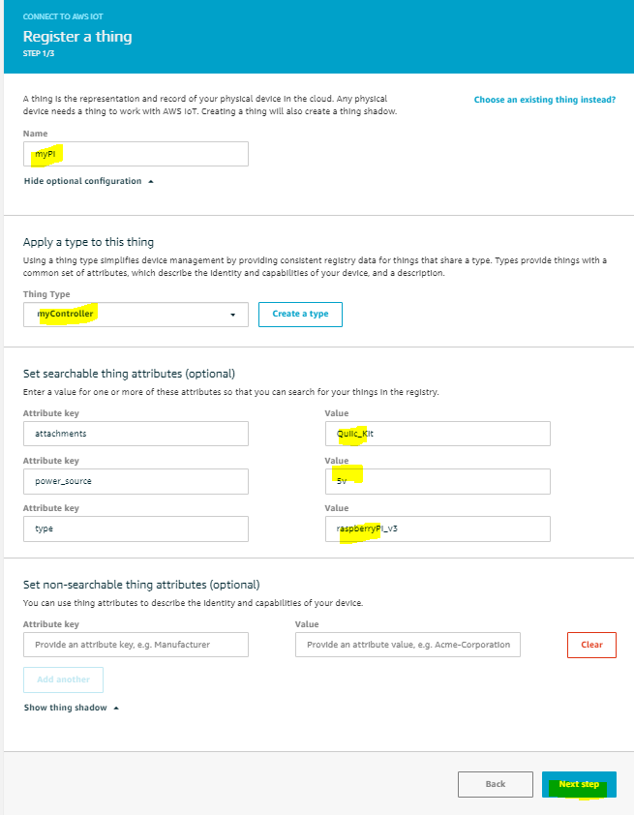
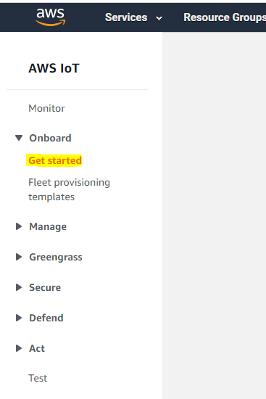
Onboard Device

Slide 7
